Slide 1
Teenage Pregnancy

Slide 2
Unplanned pregnancy
Teenage pregnancy is a pregnancy that occurs in an adolescent .
When you have a unplanned pregnancy you feel sad, alone, and confused.
You don’t know what you are going to do or how are you going to tell your parents.

Slide 4
Teenage pregnancy
Some girls feel alone and sad because they are pregnant.
You are not alone, you can ask for help at www.livestrong.com/teenpregnancy.

Slide 6
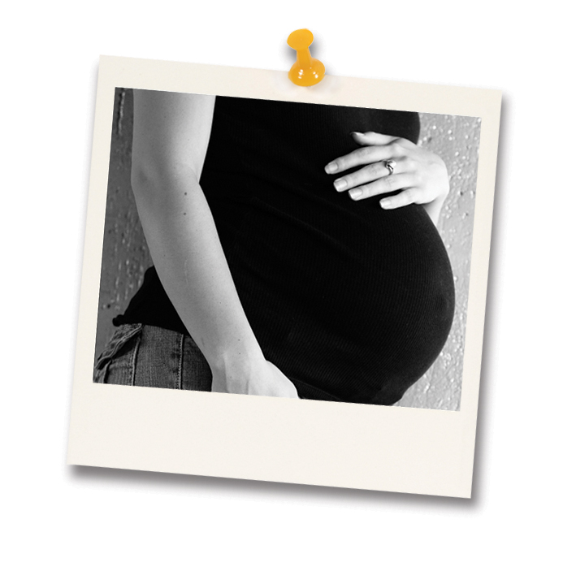
A pregnancy for a girl!
A pregnancy for a young girl is difficult because you want to finish school and look for a job.
You are afraid to tell your parents or your boyfriend. You feel confused and you don’t know what you’re going to do.
It’s better to talk to a counselor and get some options about what you’re going to do.

Slide 7
Adoption
Sometimes a teenage girl decides to keep the baby, give it up for adoption, or abort.
You can look for websites for information about adoption for the baby or look for a phone number.
You can also try: www.americanadoption.com or you can call 1-800-adoption
Another website is: www.adoptionhelp.org

Slide 8
Keep the Baby
If a teen decides to keep their baby:
Teens still need somewhere to learn parenting skills.
Young parenting classes are available for teens in the community.
Contact Lake Tahoe Unified School District & The Women’s Center.

Slide 9
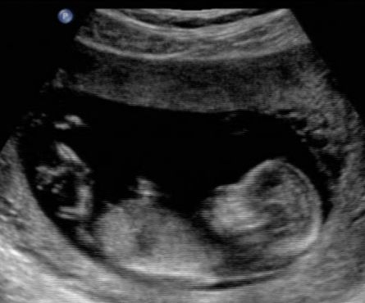
My Own Story
II I am writing and telling you that you’re not alone because I was pregnant. I have my baby. She is a girl. She is 10 months old. I experienced the same thing.
At first when I found out that I was pregnant. I felt sad, confused, and cried everyday because I thought that I was alone .

Slide 10
After my mom found out she was upset with me, but now she is very happy. She loves her granddaughter.
Today I have my daughter and I am still in high school. This is my last year. I am very strong because I passed through so many things that were hard.

Slide 11
Birth Control!!
Before you have sex, protect yourself before you get pregnant. THINK TWICE!!
You know there are methods so you can protect yourself so you don’t get pregnant!!!!

Slide 13
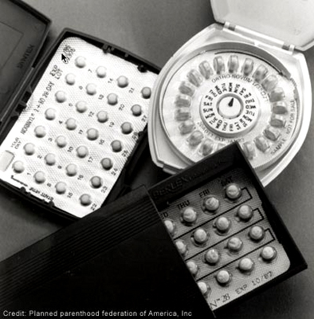
You can go to a clinic and ask for Birth Control.
So you don’t become a teen mom!!!
PROTECT YOURSELF!!!!

Slide 15
Help for Birth Control!!!
Here is a website & a phone number for birth control
www.birthcontrol.com
(800) 762- 2264 x 349
Thank you to Shakira for the song…

